Slide 1

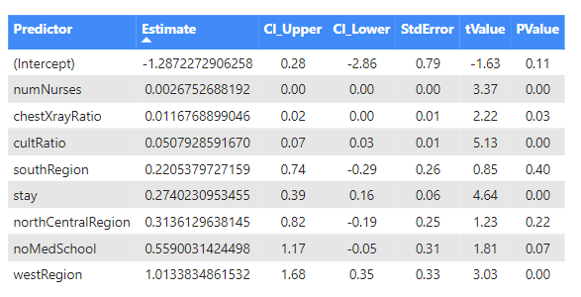
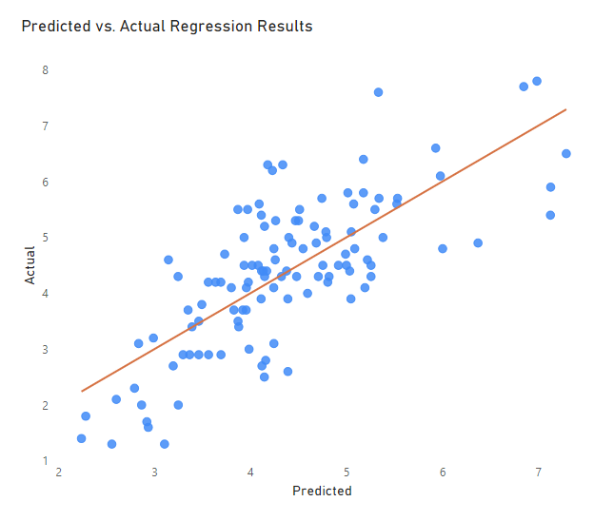
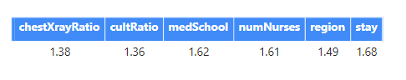
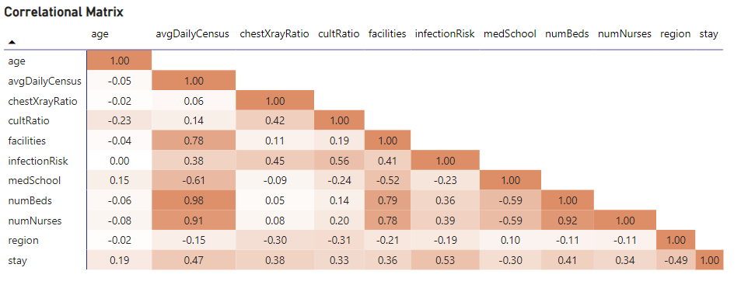
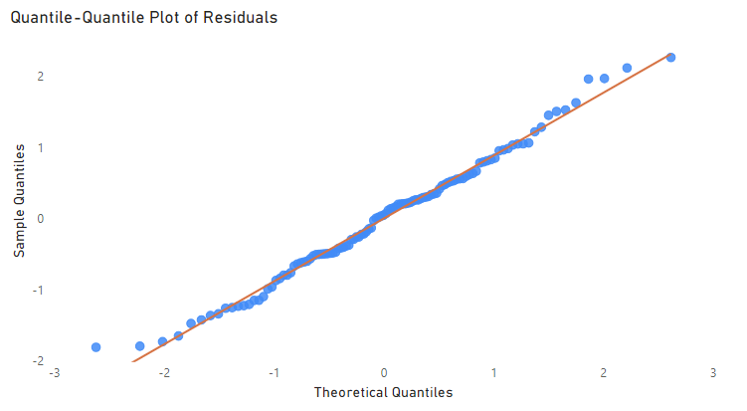
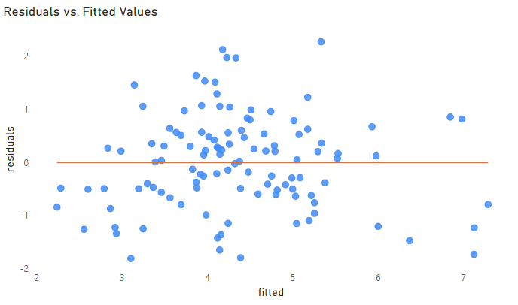

Stepwise Multiple Linear Regression Model of Hospital-Acquired Infection in the United States
Barbara Lorenzo and Eric Hernandez, Ph.D.
Miami Dade College, Kendall Campus, Miami, FL
Abstract
Results
Conclusion
This project utilizes a stepwise multiple linear regression model to analyze the efficacy of nosocomial infection control (SENIC) across hospitals in the United States (U.S.). Nosocomial infections, or hospital-onset infections, pose significant challenges to healthcare systems, resulting in increased morbidity and healthcare costs. Effective infection control measures are crucial for mitigating these adverse outcomes. The SENIC Project, a comprehensive survey conducted by the Centers for Disease Control and Prevention (CDC), provides a
reliable dataset to evaluate infection control programs.
This analysis uses stepwise multiple linear regression techniques on a sample of U.S. hospitals to identify significant predictors of infection control efficacy, including but not limited to hospital size, patient demographics, and geography. The stepwise approach allows for the systematic inclusion and exclusion of continuous variables based on their statistical
significance, ensuring consistency and conciseness.
Summary Statistics for Stepwise AIC Regression Model
Predicted vs. Actual Values Plot
Below, where k = numbers of predictors, the hypotheses, which tested for the significance of each predictor in the regression model:
Ho: ${\text{β}}_{1}$ = ${\text{β}}_{2}$ = … = ${\text{β}}_{k}$ = 0
Ha: At least one ${\text{β}}_{k}$ ≠ 0
The resulting model included the following predictors as significant of nosocomial infection with an associated change in infection risk of:
Each additional nurse employed results in an increase of 0.003
A unit increase in ratio of chest X-ray results in an increase of 0.01
An increase in the ratio of cultures results in an increase of 0.05
Each additional day in a hospital stay results in an increase of 0.27
Hospitals not affiliated with a medical school show a significant difference in infection rate when compared to having an affiliation of 0.56
Hospitals in the west region show a significant difference in infection rate when compared to hospitals in the northeast region of 1.01
Based on the p-value, we reject the null hypothesis in favor of the alternative indicating that at least one predictor significantly influences the infection risk. The model explains 56% of the proportion of variability in hospital-acquired infection.
Table 1: This table presents the summary statistics for each predictor included in the final model, which serves as an overview of the key factors analyzed in relation to infection risk.
Figure A: Comparison of predicted infection risk values from the regression model with the actual observed values, illustrating the model’s accuracy in predicting infection risk.
Introduction
Final regression equation:
predicted infectionRisk = −1.287227 + (0.274023 ⋅ stay) + (0.050793 ⋅ cultRatio) + (0.011677 ⋅ chestXrayRatio) + (0.559003 ⋅ medSchool) + (0.313613 ⋅ region2) + (0.220538 ⋅ region3) + (1.013383 ⋅ region4) + (0.002675 ⋅ numNurses)
Variance Inflation Factor (VIF) Values
In the 1970s, the CDC initiated the “Study on the Efficacy of Nosocomial Infection Control” (SENIC) with the goal of minimizing nosocomial infection rates. The results from this survey provide a reliable dataset of 113 patient encounters to evaluate infection control programs. Our research utilizes this dataset to identify key factors influencing infection control effectiveness. By focusing valuable resources on these factors, healthcare administrators can:
enhance infection control measures
reduce the likelihood of nosocomial infections
save time and funding
improve patient outcomes
This study aims to provide actionable insights that contribute to more effective infection control strategies and better healthcare practices.
Table 2: This table presents VIF values for each selected predictor. Values above 10 indicate high multicollinearity affecting model reliability.
Discussion
Correlational Matrix
For future research we recommend including interactions between predictors which could potentially improve the R squared value.
Strong positive / negative correlation
Moderate positive / negative correlation
Weak positive / negative correlation
No Correlation
References
Methodology
Figure B: Strong correlation between predictors may indicate multicollinearity, suggesting that predictors influence one another rather than infection risk.
Centers for Disease Control and Prevention. (1993, October 23). Environmental lead protoporphyrin screening: United States, 1988-1991. Morbidity and Mortality Weekly Report, 42(41), 797-799. Retrieved from https://www.cdc.gov/mmwr/preview/mmwrhtml/00017800.htm
Lloyd R. Jaisingh. "Applied Statistics in Business & Economics, 6th edition." PowerPoint Presentation.
All statistical analysis was conducted using R programming and all results were exported as a “.csv”. Data visualizations were created using Microsoft Power BI.
Correlational Analysis:
Before we initialized our model, we analyzed our predictors to identify possible correlation that could influence our results. We produced a matrix to show correlation coefficients for all pairs possible.
Simple and Multiple Linear Regression:
We conducted both simple and multiple linear regression analysis to better understand the relationships between predictors and response. During this phase, we did not identify concerns regarding assumptions, however, multicollinearity amongst certain predictors were discovered.
Stepwise AIC Multiple Linear Regression:
The stepwise approach allows for the systematic inclusion and exclusion of continuous variables based on their statistical significance, by backward elimination and forward selection.
In the diagnostic plots below, we checked for assumptions. Since the observations are independent of one another, autocorrelation was not of concern.
QQ Plot of Residuals
Residual Plot
Acknowledgements
The original research summarized in the following was supported, in part, by U.S. Department of Education grant awards: P120A200007 (STEM AISLE), P031C210035 (STEM PACTS), P031C210028 (STEM SMART) and P031A220012 (Engine of Progress);
Any opinions, findings, conclusions, or recommendations expressed in this material are those of the authors and do not necessarily reflect the views of the funding agency.
Figure C: The errors are normally distributed.
Figure D: The errors have constant variance.

